Slide 1
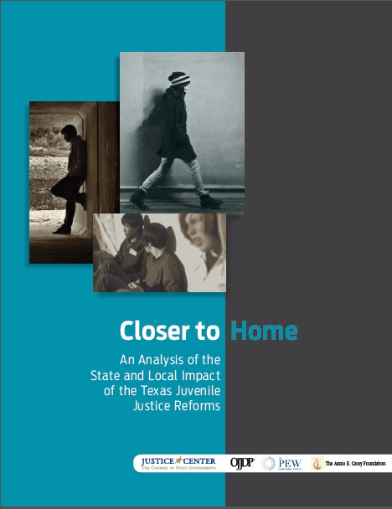
Closer to Home
A Review of Findings
Coordinating Council on Juvenile Justice and Delinquency Prevention
Michael Thompson, Director
June 22, 2015

Slide 2
Connecticut
Rhode Island
Mississippi
Tennessee
Georgia
Louisiana
Arizona
South Carolina
North Carolina
California
Wisconsin
New York
Alaska
Washington
New Jersey
Maryland
Texas
Montana
Delaware
United States
Minnesota
Ohio
Alabama
New Hampshire
Illinois
Massachusetts
Michigan
Kentucky
Virginia
Florida
Kansas
New Mexico
Oklahoma
Nevada
Hawaii
Maine
Indiana
Colorado
Iowa
Oregon
Pennsylvania
Wyoming
Missouri
Vermont
Utah
South Dakota
Arkansas
States’ dramatic progress in
reducing confinement rates
PERCENT CHANGE IN STATE COMMITMENT RATES
(1997-2011)
Nebraska
North Dakota
Idaho
West Virginia
Estimated In-School Suspensions Nationally
Estimated Out-of-School
Suspensions Nationally
*Office of Juvenile Justice and Delinquency Prevention, Easy Access to the Census of Juveniles in Residential Placement.
Available at ojjdp.gov/ojstatbb/ezacjrp

Slide 3
Texas juvenile justice system overhauled
REFORM HIGHLIGHTS and AVERAGE DAILY POPULATION
IN STATE-SECURE JUVENILE FACILITIES
2011 LEGISLATURE
Merged former Texas Youth Commission and Texas Juvenile Probation Commission to form Texas Juvenile Justice Department (TJJD)
2013 LEGISLATURE
Mandated TJJD to close one additional state-run secure facility; $25 million designated for community mental health services
2007 LEGISLATURE
Prohibited commitment to state-run secure facilities for misdemeanor offenses; age of state jurisdiction reduced from 21 to 19; $60 million in new funding for counties
2009 LEGISLATURE
$45 million for Commitment Reduction Program, with incentive funding for counties and community supervision

Slide 4
High rearrest rates for youth under
juvenile justice supervision in Texas
REARREST RATE FOR YOUTH ON PROBATION AND RELEASED FROM STATE-RUN SECURE FACILITIES, ONE, THREE AND FIVE YEAR RATE

Slide 5

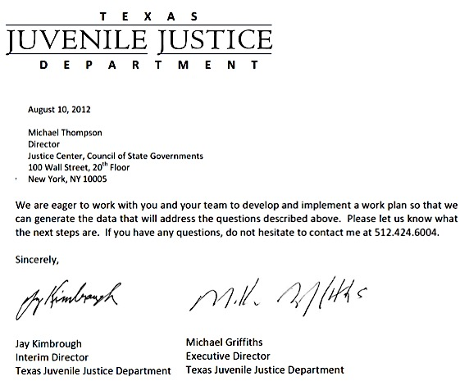


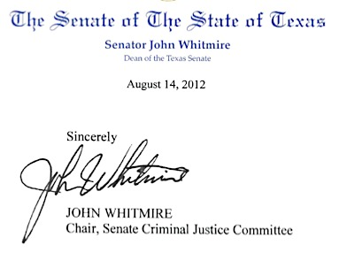


Texas state leaders asked:
“What impact did the reforms have?”
Request:
Funding:
Partners:

Slide 6
Dramatic decrease in the number of youth in state-run juvenile correctional facilities after 2007 reforms
% Change
FY04-06 | FY07-14
AVERAGE ADP
-2%
-70%
TOTAL ADMISSIONS
AVERAGE ADP

Slide 7
Proportionate decline in commitments cross white, Hispanic, and African-American youth
DISPOSITIONS RESULTING IN COMMITMENT TO STATE SECURE FACILITIES BY RACE

Slide 8
Juvenile arrests in Texas dropped
while number of youth incarcerated declined
  JUVENILE ARREST RATE (PER 100,000 POPULATION) 2000-2012
  FOR TEXAS, FLORIDA, AND CALIFORNIA
Source for juvenile population: www.ojjdp.gov, Easy Access to Juvenile Populations: 1990-2013

Slide 9
Youth on probation less likely to be rearrested than youth with nearly identical characteristics released from state-run secure facilities
One Year Probability of Rearrest
First Recidivism Offense a Felony
YOUTH RELEASED FROM STATE-RUN SECURE FACILITIES
41%
49%
YOUTH SUPERVISED IN THE COMMUNITY
34%
17%
Youth released from state-run secure facilities were 21% more likely to rearrested
Youth released from state-run secure facilities were 3x more likely to commit a felony when recidivating

Slide 10
Per capita funding for juvenile probation
increased significantly after reforms
FY2005
FY2012
% Change
Per capita expenditures for local juvenile probation departments
$3,555
$7,023
98%

Slide 11
After reforms, rearrest rates did not improve and were comparable for all interventions
PRE-REFORM
STUDY GROUP
One Year Probability
of Rearrest
POST-REFORM
STUDY GROUP
One Year Probability
of Rearrest
State Incarceration
41%
41%
Skill-Based Program
29%
27%
Treatment Program
28%
30%
Surveillance Program
31%
29%
Secure County Placement
33%
34%
Non-Secure County Placement
35%
35%
No Intervention
33%
32%

Slide 12
Expected recidivism rates compared to
actual recidivism rates
EXPECTED
REARREST RATE
ACTUAL
REARREST RATE
Tarrant
36%
46%
HIGHER
Travis
37%
44%
Victoria
30%
40%
Harris
37%
39%
AS
EXPECTED
Lubbock
33%
33%
Cameron
34%
28%
LOWER
Dallas
31%
27%
El Paso
32%
28%

Slide 13
Key Takeaways for Texas
Texas has reduced the number of youth incarcerated in its state-run secure facilities without compromising public safety.
Youth supervised “closer to home” have lower rearrest rates than similar youth released from state-run secure facilities.
The state has invested some of the hundreds of millions saved, which resulted from the closure of eight state-run secure facilities, in community-based supervision and services.
Recidivism rates for youth under community supervision have not improved since the reforms. Texas is not realizing the full potential of its investment in community based supervision and services

Slide 14

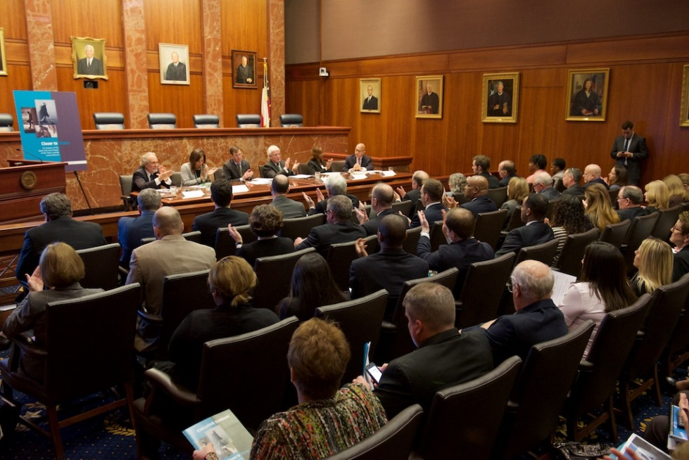
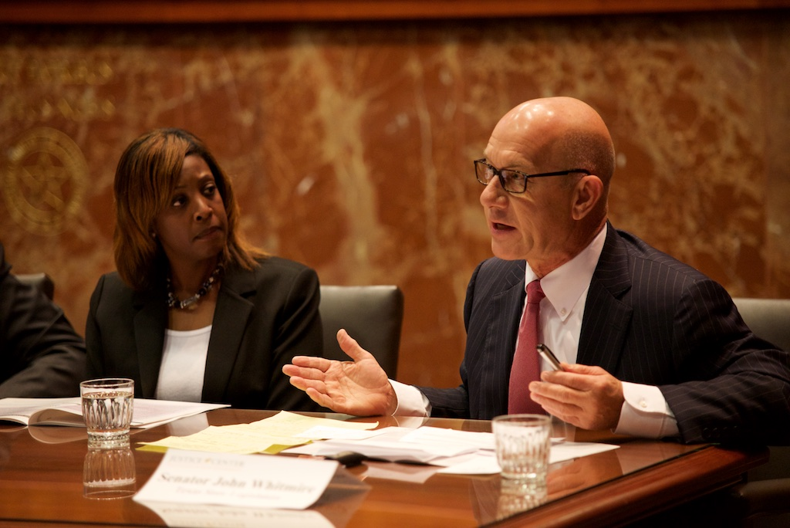

Report released Jan. 29, 2015 at TX Supreme Court

Slide 15
  Legislation passed in response to report findings
Report Finding:
Youth released from state-run secure facilities were 21% more likely to rearrested
Texas SB 1630:
Further limits the commitment of youth to state secure facilities
Requires juvenile departments to develop regionalization plans to keep youth “closer to home”

Slide 16
  Legislation passed in response to report findings
Report Finding:
Gaps in use of best practice have kept Texas from realizing the full potential of their investment in community interventions
Texas SB 1630:
Requires the development of research- based programs for youth in the community and those committed
Establishes performance based goals and ties funding to these goals
Creates a new TJJD division responsible for monitoring program quality and accountability

Slide 17
DOJ can help states and counties to:
Take a hard look at impact of reforms they have enacted
Minimize incarceration of youth in state correctional facilities
Improve outcomes for youth under community-based supervision

Slide 18
Thank You
FULL REPORT AT:
http://csgjusticecenter.org/youth/publications/closer-to-home/
HOME PAGE AT:
http://csgjusticecenter.org
The presentation was developed by members of the Council of State Governments Justice Center staff. The statements made reflect the views of the authors, and should not be considered the official position of the Justice Center, the members of the Council of State Governments, or the funding agency supporting the work. Citations available for statistics presented in preceding slides available on CSG Justice Center web site.

