Slide 1
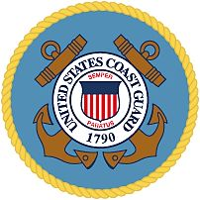

Slide 2
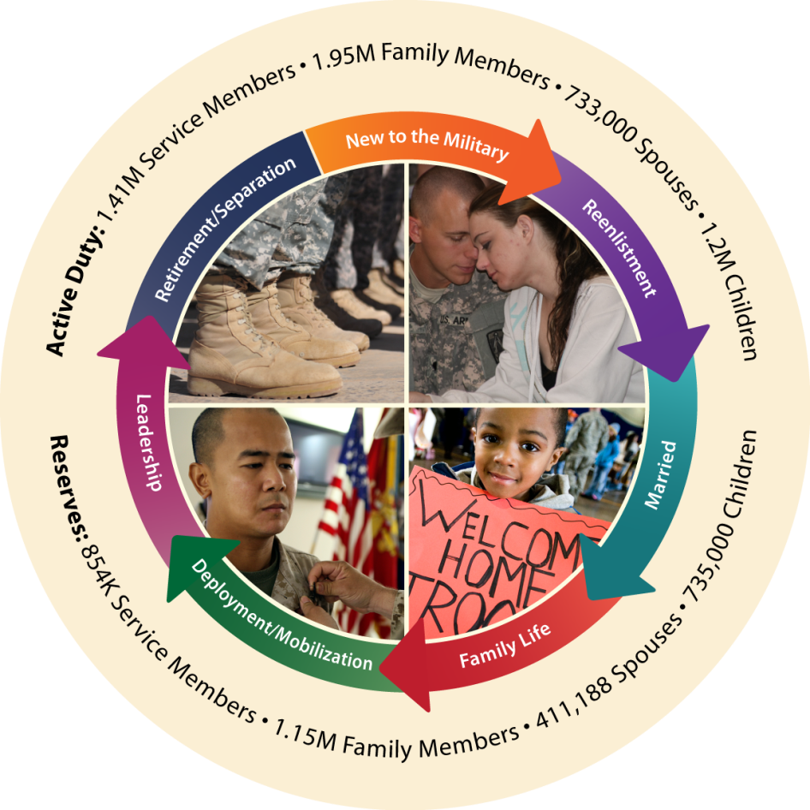
Military Community & Family Policy
Family Support
Military OneSource Call Center and Web site
Military and Family Life Counselors (MFLC) Potential pool of 40,000
54 Joint Family Support Assistance Program Teams (one per state and territory)
267 Family Centers (Relocation, Financial, Employment, etc.)
Morale, Welfare & Recreation
Deployment support:
free internet, fitness and recreation
11,000+ Installation fitness, library, food and beverage, and lodging facilities worldwide
66,500 MWR employees
State Liaison & Educational Opportunities
11 State Liaisons. 10 Issues,
50 States 526,000 Voluntary
Education participants in FY10
With 350 Education Centers
Children & Youth Support
350 Youth Centers
953 Child Development Centers
5,500 Family Child Care Homes
Family Advocacy
169 New Parent Support Programs
238 Child & Domestic Abuse Programs
Department of Defense Education Activity (DoDEA)
194 Schools with 93,229 students in
12 Countries, 7 States, 2 Territories
Exceptional Family Member
Assignment Coordination
Family Support – 390,000 potential exception family members
Exchanges
302 Main Stores and 5,237 Retail (service and food) Outlets with 61,205 Employees
Casualty Assistance
Military Funeral Honors 36,713 in 2010
44,447 YTD 2011
Fatalities
1,479 in 2010
245 YTD 2011
Defense Commissary Agency (DeCA)
247 Commissary Stores
17,967 Employees
Armed Forces Retirement Homes
Gulfport, MS & Washington, DC
Independent, assisted living and long term care for 1,200 eligible veterans

Slide 3
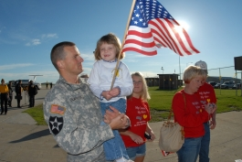
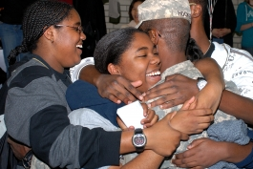
Supporting Our Military Families

